Slide 1


Noida Institute of Engineering and Technology, Greater Noida
Cultural Heritage and Performing Arts
(Module-V)
Module: 5
Essence of Indian Traditional Knowledge
AMICANC0502
Ms. Neha Singh
MCA Department
MCAINT VI semester

Slide 2
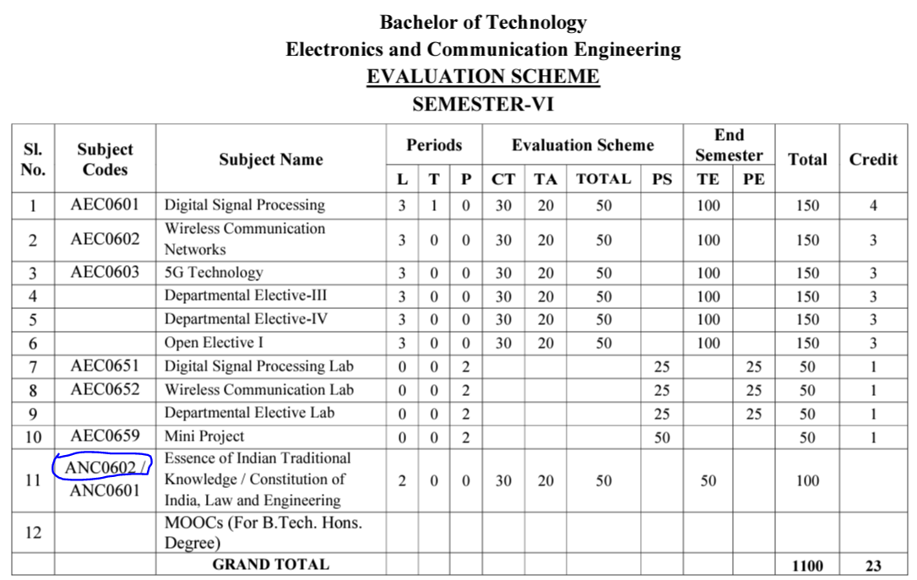
Evaluation Scheme (EC-6th Semester)

Slide 3
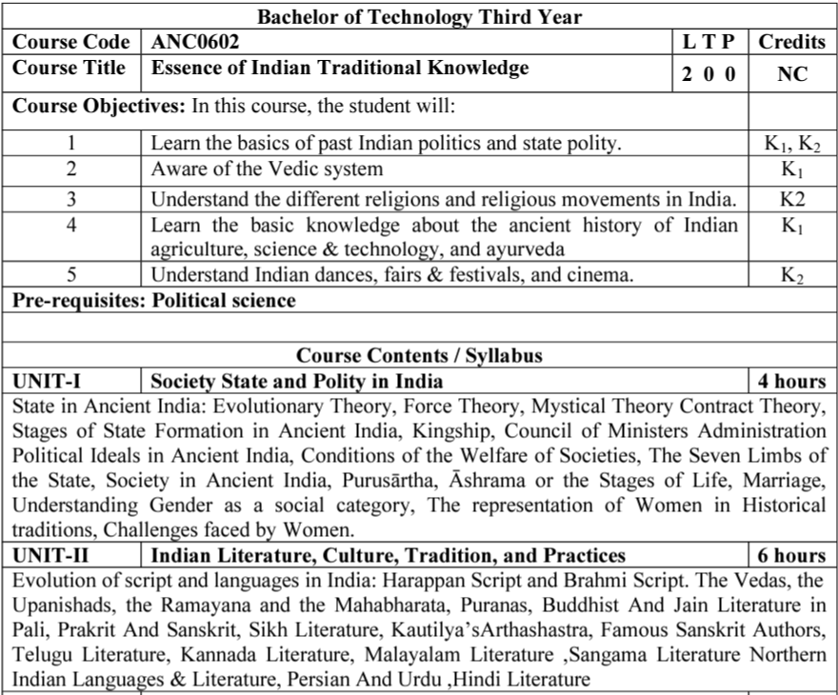
Syllabus

Slide 4
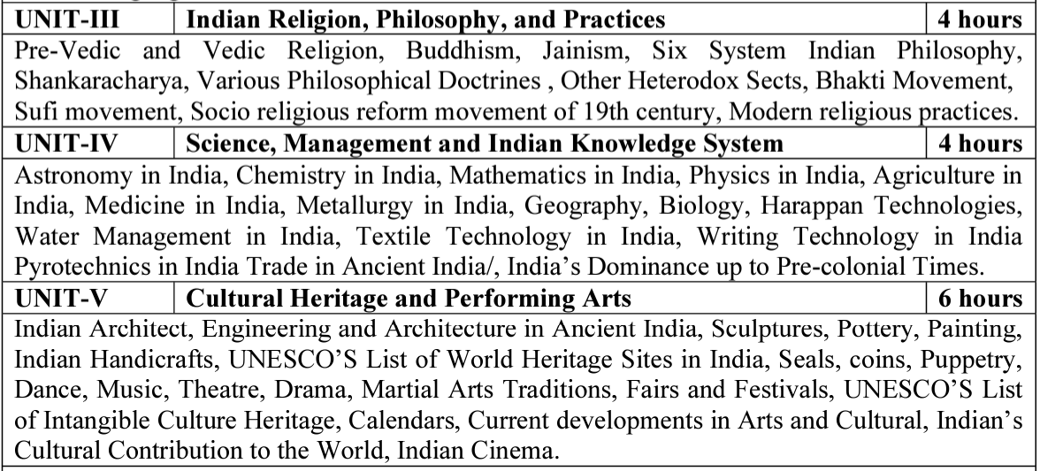
Syllabus(Continue….)

Slide 5
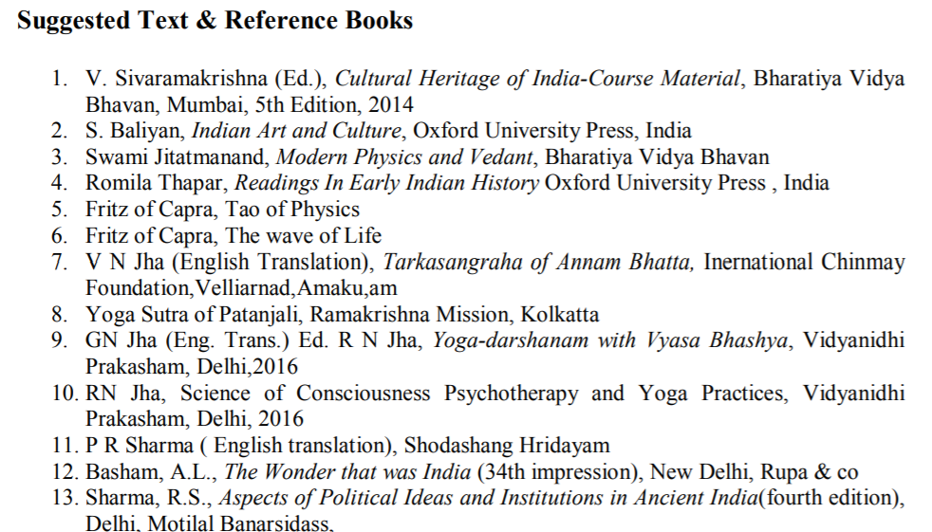
Text Books

Slide 6
Applications of Essence of Indian Traditional Knowledge
Can apply the old designing concept with blend of new trends in building construction
Learn the ancient living style
Indian Traditional knowledge modern scientific perspective
Apply the ancient advanced architectural wonders in current trends

Slide 7
Course Objective
Course Objectives:
The student will try to learn about:
To imparting the basic principles of thought process, reasoning and inference to identify the roots and details of some of the contemporary issues faced by our nation and try to locate possible solutions to these challenges by digging deep into our past.
To enable the students to understand the importance of our surroundings and encourage the students to contribute towards sustainable development.

Slide 8
Course Objective(Continue…)
To sensitize students towards issues related to ‘Indian’ culture, tradition and its composite character.
To make students aware of holistic life styles of Yogic-science and wisdom capsules in Sanskrit literature that are important in modern society with rapid technological advancements and societal disruptions.
To acquaint students with Indian Knowledge System, Indian perspective of modern scientific world-view and basic principles of Yoga and holistic health care system.

Slide 9
Course Outcome
At the end of this course students will able to:
CO1: Understand the basic principles of thought process & inference to identify the roots and details of some of the contemporary issues faced by our nation and try to locate possible solutions to these challenges by digging deep into our past.
CO2: Illustrate the importance of our surroundings and encourage the students to contribute towards sustainable development.
CO3: Interpret the issues related to ‘Indian’ culture, tradition, & its composite character.

Slide 10
Course Outcome (Continue…)
CO4: Aware of holistic life styles of Yogic-science and wisdom capsules in Sanskrit literature that are important in modern society with rapid technological advancements and societal disruptions.
CO5: Acquaint students with Indian Knowledge System, Indian perspective of modern scientific world-view and basic principles of Yoga and holistic health care system.

Slide 11
Program Outcomes
Program Outcomes are narrow statements that describe what the students are expected to know and would be able to do upon the graduation.
These relate to the skills, knowledge, and behavior that students acquire through the programmed.
Engineering knowledge
Problem analysis
Design/development of solutions
Conduct investigations of complex problems
Modern tool usage
The engineer and society
Environment and sustainability
Ethics
Individual and team work
Communication
Project management and finance
Life-long learning

Slide 12
Program Specific Outcomes
Program Specific Outcomes (PSOs) are what the students should be able to do at the time of graduation. The PSOs are program specific. PSOs are written by the department offering the program.
On successful completion of B. Tech. (EC) Program, the Electronics and Communication engineering graduates will be able to:
PSO1: To apply the knowledge of mathematics, science and electronics & communication engineering to work effectively in the industry based on same or related area.
PSO2: To use their skills to work in modern electronics & communication engineering tools, software and equipments to design solutions for complex problems in the related field that meet the specified needs of the society.
PSO3: To function effectively as an individual and as a member or leader of a team by qualifying through examinations like GATE (Graduate Aptitude Test in Engineering), IES (Indian Engineering Services), PSUs (Public Sector Undertakings), TOEFL (Test of English as a Foreign Language), GMAT (Graduate Management Admission Test) and GRE (Graduate Record Examinations in US) etc.

Slide 13
CO-PO and PSO Mapping
CO | PO1 | PO2 | PO3 | PO4 | PO5 | PO6 | PO7 | PO8 | PO9 | PO10 | PO11 | PO12 | PSO1 | PSO2 | PSO3
CO1 | - | - | - | - | - | - | - | 3 | - | - | - | 3 | - | - | -
CO2 | - | - | - | - | - | - | - | 3 | - | - | - | 3 | - | - | -
CO3 | - | - | - | - | - | - | - | 3 | - | - | - | 3 | - | - | -
CO4 | - | - | - | - | - | - | - | 3 | - | - | - | 3 | - | - | -
CO5 | - | - | - | - | - | - | - | 3 | - | - | - | 3 | - | - | -
Avg | - | - | - | - | - | - | - | 3 | - | - | - | 3 | - | - | -
*3= High *2= Medium *1=Low

Slide 14
Program Educational Objectives
The Program Educational Objectives (PEOs) of an engineering degree program are the statements that describe the expected achievements of graduates in their career, and what the graduates are expected to perform and achieve during the first few years after graduation.
PEO1: To have an excellent scientific and engineering breadth so as to comprehend, analyze, design and solve real-life problems using state-of-the-art technology.
PEO2: To lead a successful career in industries or to pursue higher studies or to understand entrepreneurial endeavours.
PEO3: To effectively bridge the gap between industry and academics through effective communication skill, professional attitude and a desire to learn.

Slide 15
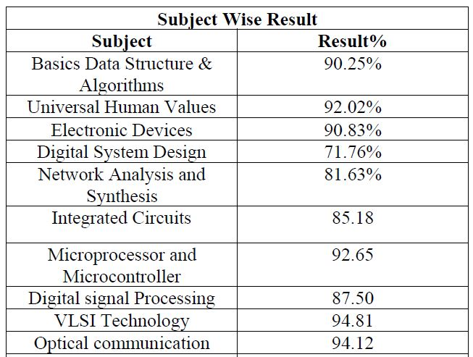
Result Analysis
Faculty Name | Subject Code | Section A | Section B
Mr. Anshu Kumar | ANC 0602 | 100 % | 100 %

Slide 16
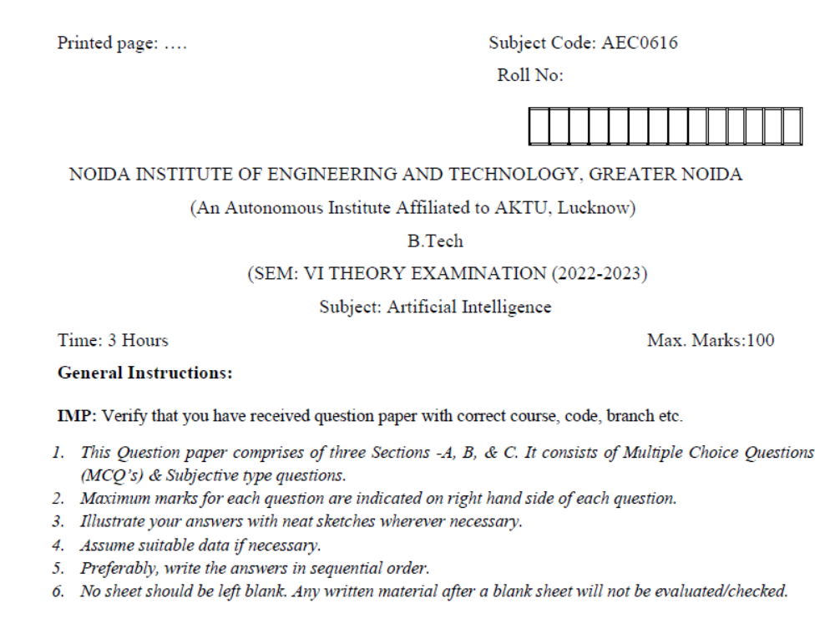
Question Paper Template

Slide 17
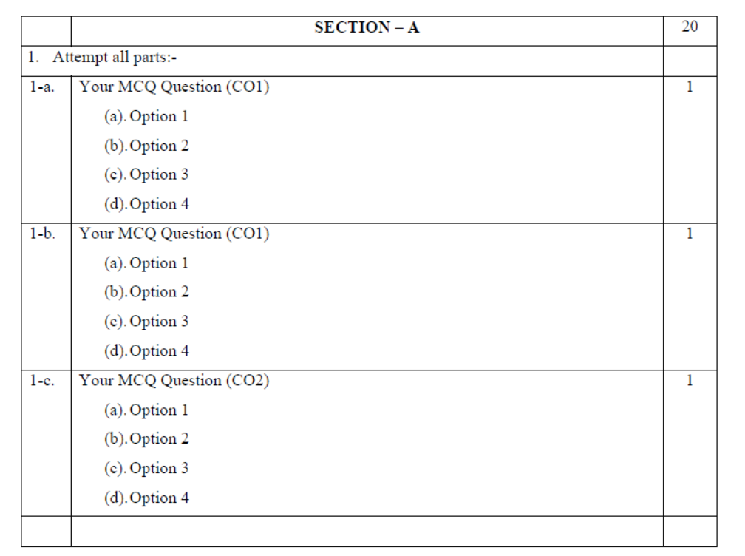
Question Paper Template (Cont……)

Slide 18
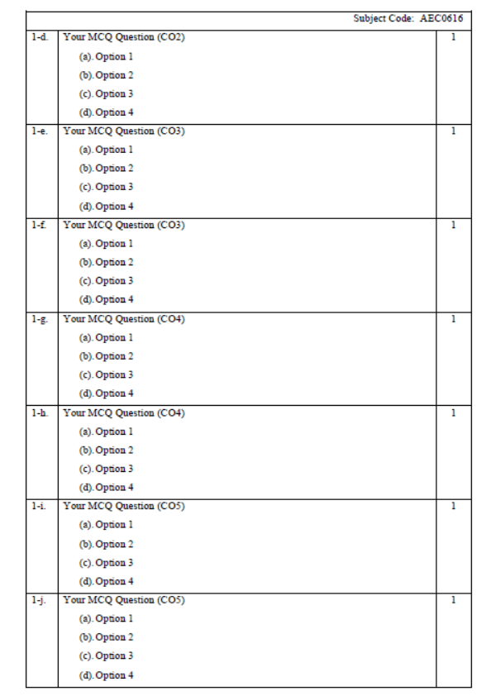
Question Paper Template (Cont……)

Slide 19
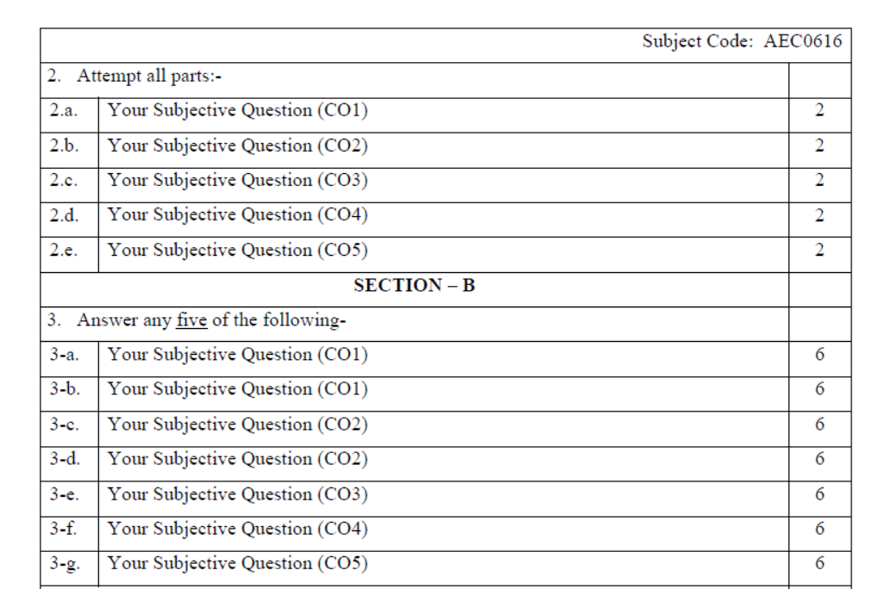
Question Paper Template (Cont……)

Slide 20
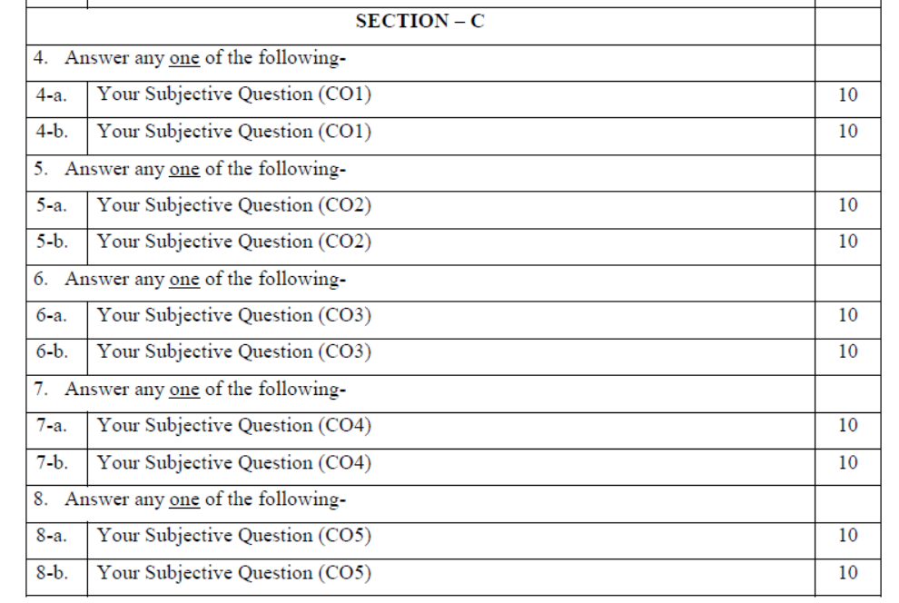
Question Paper Template (Cont……)

Slide 21
Prerequisite and Recap
Basic knowledge of Indian traditions, culture & society.

Slide 22
Brief Introduction about the subject with Video
The course aims at imparting basic principles of thought process, reasoning and inference & to identify the roots and details of some of the contemporary issues faced by our nation and try to locate possible solutions to these challenges by digging deep into our past. To enable the students to understand the importance of our surroundings and encourage the students to contribute towards sustainable development. To sensitize students towards issues related to ‘Indian’ culture, tradition and its composite character.
https://www.youtube.com/watch?v=jgQlf3DM_GU&t=625s

Slide 23
Content
Indian Architect, Engineering and Architecture in Ancient India,
Sculptures, Pottery,
Painting, Indian Handicraft,
UNESCO’S List of World Heritage sites in India,
Seals, coins, Puppetry,
Dance, Music, Theatre, drama, Martial Arts Traditions,
Fairs and Festivals,
UNESCO’S List of Intangible Cultural Heritage,
Calendars, Current developments in Arts and Cultural,
Indian’s Cultural Contribution to the World
Indian Cinema.

Slide 24
Prerequisite
Basic knowledge of Architecture
Basic knowledge of Indian Tradition & Culture.

Slide 25
Module 5 Objective
To acquaint students with Indian Knowledge System, Indian perspective of modern scientific world-view and basic principles of Yoga and holistic health care system.

Slide 26
Topic Objective
Topic No. | Topic Objective
1 | To study the Indian Architect & Engineering and Architecture in Ancient India

Slide 27
Topic Mapping
S.No. | Topic | Course Outcome
1 | Indian Architect and Engineering and Architecture in Ancient India | CO4 & CO5

Slide 28
Indian Architecture (CO4 & CO5)
The word ‘architecture’ is derived from the Latin word ‘tekton’ which means builder. When the early man began to build his shelter to live in, the science of architecture started.
Sculpture, on the other hand, is derived from Proto-Indo-European (PIE) root ‘kel’ which means ‘to bend’.
Sculptures are small works of art, either handmade or with tools and are more related to aesthetics than engineering and measurements.
Architecture refers to the design and construction of building whereas Sculptures are relatively small 3-dimensional works of art.

Slide 29
Indian Architecture
Architecture uses a mixture of various type of materials like stone, wood, glass, metal, sand, etc. but a single piece of sculpture is usually made of a single type of material.
Architecture involves study of engineering and engineering mathematics. It requires detailed and accurate measurements whereas Sculpture involves creativity and imagination and may not depend as heavily on accurate measurements.
Example of architecture are Taj Mahal, Red Fort, etc.
Example of Sculpture are Nataraja Image, Dancing Girl, etc.

Slide 30
Indian Architecture
The story of Indian art and architecture is a story of evolution. From the ancient Indus Valley Civilisation to the British rule, the buildings and sculptures have a narrative of their own.
The emergence and decay of great empires, the invasion of foreign rulers who gradually became indigenous, the confluence of different cultures and styles, etc. are all reflected in the evolution of Indian architecture and sculpture.
Architecture is the finest expression of human creativity.
The monuments are living examples of the values, beliefs and thinking processes of the masses as well as the classes.

Slide 31
Indian Architects
Achyut Kanvinde (1916-2002):-
Achyut Kanvinde, who also worked with Modernist architect and Bauhaus founder Walter Gropius, dealt in proportional geometry, economical shapes, steel frames, and reinforced concrete.
Brinda Somaya (b. 1949) :-
To be “the conscience of the built and unbuilt environment” is the philosophy that energizes Brinda Somaya’s practice. Her work unites architecture with social equity and conservation.
She has both built and conserved structures with attention to preserving their historic significances.

Slide 32
Indian Architects
B. V. Doshi (b. 1927) :-
Before practicing in India, B.V. Doshi worked with Modernist and contemporary giants Le Corbusier and Louis Kahn. Doshi retains a Modernist edge but adds a distinctive Indian spirit.
Charles Correa (b. 1930) :-
At the frontier of contemporary Indian architecture, Charles Correa is adept at sensitively meeting needs and preserving history.
At Kanchanjunga Apartments, flats reconcile courtyards and the connected spaces of traditional living with the urban context of an apartment building.

Slide 33
Indian Architects
Laurie Baker (1917-2007):-
An Englishman who gained Indian citizenship, Laurie Baker had a deep respect for spaces stored in Indian architectural methods. Because of his value for vernacular, organic, and sustainable architecture, he made use of traditional techniques and materials whilst also devising new ones.
Through these, he would shade places from heat, permit sunlight and ventilation, minimize materials, and provide unparalleled aesthetic beauty.

Slide 34
Engineering and Architecture in Ancient India (CO4& CO5)
Architecture in Harappan Civilisation :-
The remains of Harappa and Mohenjo-Daro reveal a remarkable sense of town planning.
The towns were laid out in a rectangular grid pattern.
The roads ran in north-south and east-west direction and cut each other at right angles.
Mainly three types of buildings have been found in the excavation sites –dwelling houses, public buildings and public baths. The Harappans used burnt mud bricks of standardised dimensions for the purpose of construction.

Slide 35
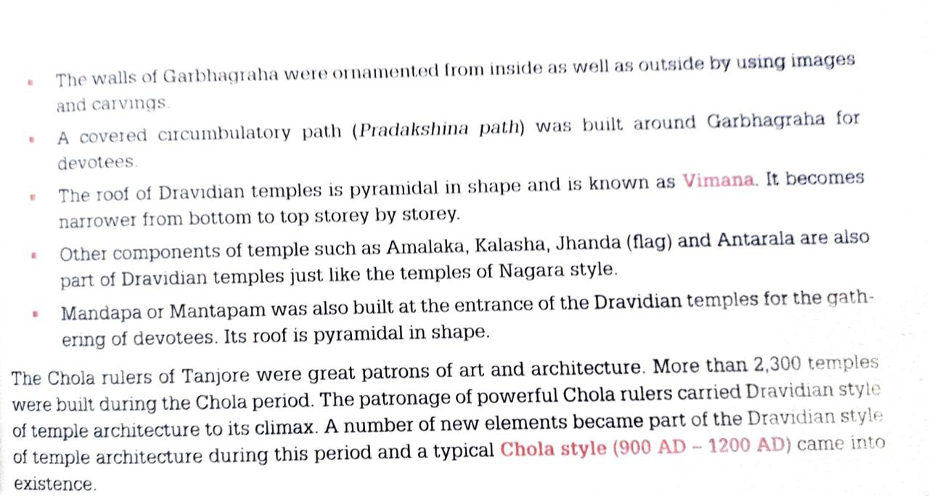
Engineering and Architecture in Ancient India

Slide 36
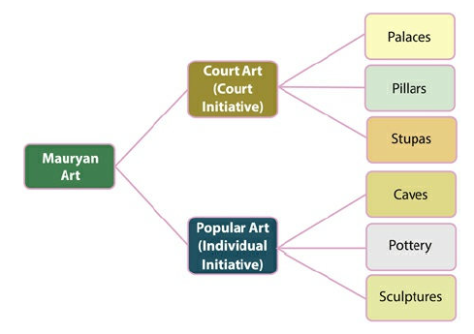
Engineering and Architecture in Ancient India
Mauryan Architecture:-
Fig:- Classification of Mauryan Art

Slide 37
Engineering and Architecture in Ancient India
Mauryan Architecture:-
Wood was the principal building material.
During the reign of Ashoka, the inscription on pillars – as a symbol of the State or to commemorate battle victories – assumed great significance.
He also used pillars to propagate imperial sermons as well.
On an average of 40 ft. height, the pillars were usually made of chunar sandstone and comprised of Shaft and Capital.
A long Shaft formed the base and was made up of a single piece of stone or monolith.

Slide 38
Engineering and Architecture in Ancient India
Stupa:
Stupas were burial mounds prevalent in India from the Vedic period. It is a conventional representation of a funeral cumulus in which relics and ashes of the dead were kept.
During the period of Ashoka, the art of stupas reached its climax. Almost 84,000 stupas were erected during his period.
Although a Vedic tradition, stupas were popularised by the Buddhists.
Sanchi Stupa in Madhya Pradesh is the most famous of the Ashokan stupas. Piprahwa stupa in Uttar Pradesh is the oldest one.

Slide 39
Engineering and Architecture in Ancient India
Popular Art(Cave Architecture):-
Rock-cut Caves
The construction of rock caves continued as in the Mauryan period. However, this period saw the development of two types of rock caves Chaitya and Vihar.
While the Vihars were residential halls for the Buddhist and Jain monks and were developed during the time of the Mauryan Empire, the Chaitya halls were developed during this time.
They were mainly quadrangular chambers with flat roofs and used as prayer halls.

Slide 40
Engineering and Architecture in Ancient India
Temple Architecture:
Nagara school of Architecture:- From 5th century AD onwards, a distinct style of temple architecture developed in the Northern part of India, known as the Nagara Style of Architecture.
The temples generally followed the Panchayatan style of temple making, which consisted of subsidiary shrines laid out in a crucified ground plan with respect to the principal shrine.
Presence of assembly halls or mandaps in front of the principal shrine. Outside the garbhagriha, images of the river goddesses Ganga and Yamuna were placed.

Slide 41
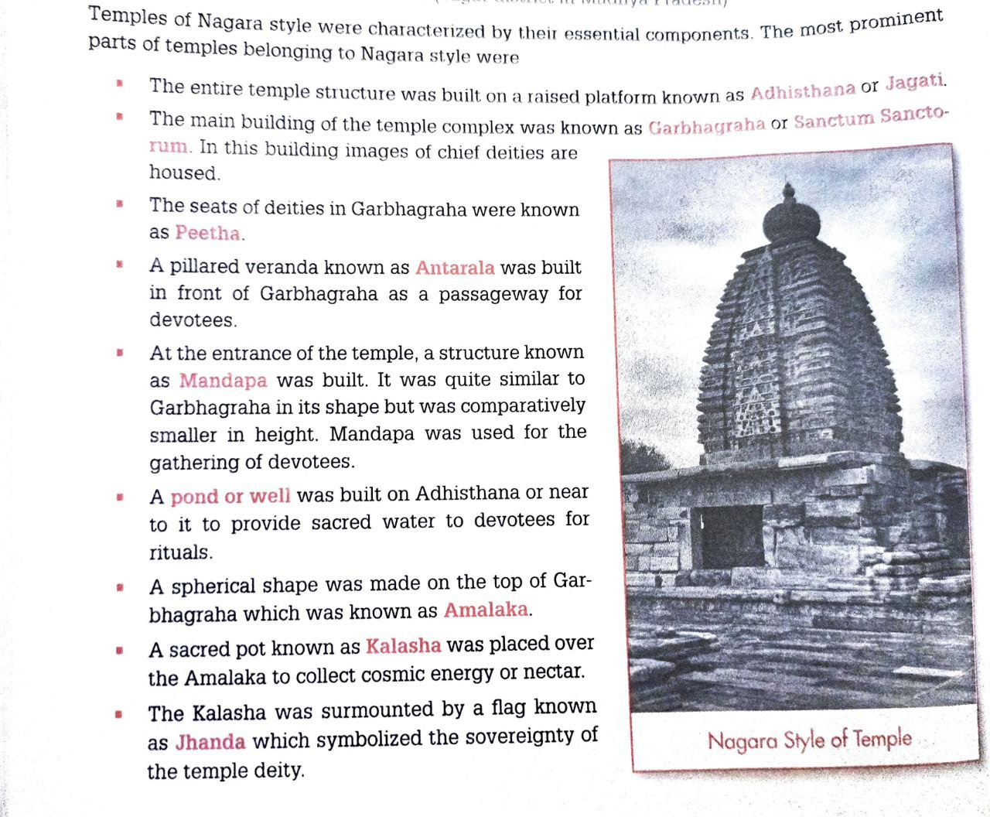
Engineering and Architecture in Ancient India

Slide 42
Engineering and Architecture in Ancient India
Dravidian Style of temple Architecture(Chola Architecture):-
Unlike the Nagara temples, the Dravidian temples were surrounded by high boundary walls.
The front wall had a high entrance gateway known as gopuram.
The temple premise was laid out in Panchayatan style with a principal temple and four subsidiary shrines.
Under Dravidian style, the spire is in the form of a stepped pyramid that rises up linearly rather than curved. It is known as vimana.
The presence of a water tank inside the temple enclosure was a unique feature of the Dravidian style.

Slide 43
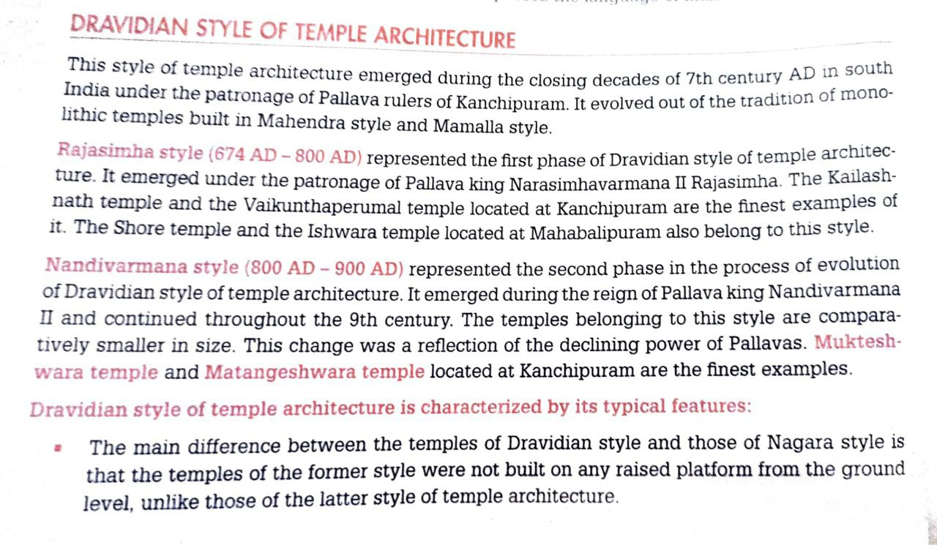
Engineering and Architecture in Ancient India

Slide 44
Engineering and Architecture in Ancient India
Nayaka School:-
The Nayaka school of architecture flourished under the Nayaka rulers in the period between 16th and 18th centuries AD. It was also known as Madurai School.
It was architecturally similar to the Dravidian style, but much larger in scope. It also had Islamic influence.
Presence of Prakarms or huge corridors in the portico, around the garbhagriha, along with roofed ambulatory passageways.
The gopurams built under the Nayaka rulers were some of the largest gopurams.

Slide 45
Engineering and Architecture in Ancient India
Modern Architecture(Indo-Gothic Style):-
Also known as the Victorian style, was a unique blend of Indian, Persian and Gothic styles of architecture.
The constructions were extremely large and elaborate in their execution.
The walls were thinner than in the Indo-Islamic constructions.
The arches were pointed, unlike the curving arches of Indo-Islamic era.
One of the unique features of the Victorian style was the use of large windows.
It adhered to advanced structural engineering standards of Britain. Steel, iron and poured concrete started being used.
Examples: Victoria Memorial in Kolkata, Gateway of India in Mumbai

Slide 46
Engineering and Architecture in Ancient India
Modern Architecture(Neo-Roman Style):-
The architectures of New Delhi, done by Edwin Lutyens and Herbert Baker were the finest examples of this style. It has been often described as the “Rome of Hindustan”.
The constructions were anonymous and without any interesting features.
It was a confluence of all styles of architecture which made the style congested and cramped the space of artistic expression.
Simplicity, modernity and utility were highly compromised due to the hybrid nature of the constructions. There was a focus on circular buildings.

Slide 47
Recap
In this topic, We learned about Indian Architect, Engineering and Architecture in Ancient India.

Slide 48
Daily Quiz
What does stupa signify?
A. Death
B. Knowledge
C. Birth
D. Parinirvana
With reference to the cultural history of India, the term Panchayatan refers to?
A. An assembly of village elders
B. A religious sect
C. A style of temple construction
D. An administrative functionary
Angkor wat temple constructed by ______.
A. King Suryavarmana I
B. King Suryavarmana II
C. King Rajaraja I
D. King Rajendra I.

Slide 49
Daily Quiz
Angkor wat temple located in ______.
A. Indonesia
B. Thailand
C. Cambodia
D. Malaysia
Who has built the Adhai din ka Jhonpra?
A. Iltutmish
B. Ibrahim Lodhi
C. Qutb-ud-din Aibak
D. Raziyyat-Ud-Dunya Wa Ud-Din
The Nagara style of architecture developed and flourished mainly in
A. South India
B. North-West India
C. North India
D. North-East India

Slide 50
Daily Quiz
Who constructed the main Sanchi Stupa?
A. Chandragupta
B. Gautama Buddha
C. Kautilya
D. Ashoka
Which of the following is not a feature of north Indian temple architecture?
A. Shikhara
B. Gupuram
C. Garbhagraha
D. Adisthana
Who among the following was the architect to lay the foundation of Delhi?
A. Corbusier
B. Charles Correa
C. Lutyens
D. Laurie Baker

Slide 51
Prerequisite
Basic knowledge of Indian Tradition & Culture.

Slide 52
Topic Objective
Topic No. | Topic Objective
1 | To study the Sculptures, Seals, coins, Pottery, Puppetry & Dance

Slide 53
Topic Mapping
S.No. | Topic | Course Outcome
1 | Sculptures, Seals, coins, Pottery, Puppetry, Dance. | CO4 & CO5

Slide 54
Sculptures (CO4&CO5)
The art of sculpture has a glorious history in India because progress in this art form has been going on since more than 5000 years.
The Harappan sculpture is an example of popular art because these figures have been discovered from private house.
Stone sculptures :-
Limestone, alabaster (gypsum like material) and steatite (soft white stone) varieties of stone were used to make sculptures. The level of refinement in them was quite high.
Example:- dancing girl found at Harappa, bearded priest found at Mohenjo-Daro and Horse found at Lothal.

Slide 55
Sculptures
Terracotta sculptures :-
Terracotta (baked clay) was also used by Harappans to make sculptures. These figure are less sophisticated or refined when compared to metal or stone figures.
Example:- An animal resembling horse found at Mohenjo-Daro.
Copper and Bronze Sculptures:-
The lost wax method was used by Harappans to make sculptures.
The figure of the Bronze Dancing girl found at Mohenjo-Daro is one of the finest examples.

Slide 56
Sculptures
Mathura School of Sculpture :-
It was the oldest school among all the three school of sculptures.
It emerged in 2nd century BC. Red sand stone was used.
Artists of Mathura were the first to make sculptures of Buddha.
Buddha of Mathura school was mostly a Yogi seated under a tree in Padmasana posture and deeply involved in meditation.
The figure of Mathura school are famous for depiction of inner beauty.
Facial expression in these figures was of very high order.
Female figures represent multitudes of gestures and postures.

Slide 57
Sculptures
Gandhara School of Sculpture :-
It emerged during second half of 2nd century BC.
Flourished in north western part of Indian subcontinent.
The Roman influence on Gandhara school was visible in the form of
1. Realistic representation of human beings.
2. Distinguished muscles of the body.
3. Hair arranged in wavy curls.
Blue or green schist ,phyllite ,wood and stucco(plaster) materials used.
Greek influence:- Round eyes, Buddha portrayed with a moustache or turban, transparent garments, mechanical rigidity in expression.

Slide 58
Sculptures
Amaravati School of Sculpture :-
Developed in Amaravati and Guntur district of Andhra Pradesh.
It emerged during second half of 2nd century BC.
White marble was the most common material.
Focused on depiction of feminine beauty.
Physical and worldly aspects of sculptures were highly developed.
Amaravati school was characterized by naturalistic and sensual appeal.
Life-size figures were made in Amaravati school. Some of them are more than 16-feet in height.
Men, animal, vegetation were treated gracefully.

Slide 59
Seals (CO4&CO5)
Seals were used to make a sealing, or positive imprint, like this modern resin one made from the original seal.
Sealings were used in ancient times for trade.
Steatite was the most common material used by Harappans to make their seal.
Numerous Indus seals have been found in ancient Mesopotamian cities.
There is evidence for settlements of Indus valley traders in ancient Mesopotamia, in the form of Mesopotamian seals with Indus language characters.

Slide 60
Seals
The dimensions of Harappan seals varied from 0.5 inch to 2.5 inch.
Most Harappan Seals were quadrilateral in shape. Square and rectangular shaped seals have been found most commonly.
Button shaped, cubical and round seals were also used by Harappans.
The seals of Mesopotamian civilization were cylindrical in shape.
Symbols like circles, crosses, dots, swastikas, tree in railing and leaves of Peepal tree were depicted on Harappan seals.
Animals like elephant, bull, tiger, rhinoceros, antelope and crocodile were depicted on seals. Unicorn was the most frequently depicted animal. Fish was the most common zoomorphic sign.

Slide 61
Seals
Significance of Harappan seals:
The seals throw light on relationship and interaction of the people of Harappan civilization with outside world.
The seals also throw light on the language and script of Harappan civilization.
Impression of cloth on some of the seals found at Lothal indicate that people of Harappan civilization practiced weaving of cloths.
The seals has boss on their back side to put thread. This indicate that seals were also worn by Harappan people like amulets in their neck.
Harappan civilization used ships in their trade and commerce.

Slide 62
Coins (CO5)
The word Coin is derived from the Latin word Cuneus and it is believed that the first recorded use of coins was in China and Greece around 700 BC and in India in the 6th century BC.
The study of coins and medallions is known as Numismatics.
The earliest coins were casted coins and were die-struck only on one side. One to five marks or symbols were incused on single side and were termed as ‘Punch Marked’ coins.
Panini’s Ashtadhyayi cites that to make punch marked coins, metallic pieces were stamped with symbols. Each unit was called ‘Ratti’ weighing 0.11 gram.

Slide 63
Coins
Historian Prameshwari Lal Gupta carried out extensive research on ancient Indian coins.
The first time coins were issued in India in the 6th century BC.
Indo-Greeks were the first to issue gold coins in India.
Kushanas issued the purest gold coins and the largest number of copper coins in Indian history.
A large number of roman coins made of gold and silver belonging to the 1st and 2nd centuries discovered in south India.
The largest number of gold coins were issued by Gupta rulers in the whole of Indian history. It helps us in determining chronology.

Slide 64
Pottery (CO5)
Pottery is one of the most important forms of expression of human creativity. It is the most sensuous of all art forms.
The earliest evidence of pottery was discovered from Chopani Mando located in Prayagraj district of Uttar Pradesh.
The potteries found at the excavation sites can be broadly classified into two kinds – plain pottery and painted pottery.
The painted pottery is also known as Red and Black Pottery as it used red colour to paint the background and glossy black paint was used to draw designs and figures on the red background.

Slide 65
Pottery
Plain pottery was used for household purposes, mainly storage of grains and water.
Miniature vessels, generally less than half an inch in size, were used for decorative purposes.
Types of pottery:
Black and Red ware pottery
Ochre coloured pottery
Painted grey ware pottery
Northern black polished ware pottery
Red ware

Slide 66
Puppetry
Puppetry is one of the ancient forms of entertainment.
This form of entertainment gives unrestricted freedom to the artist in design, colour and movement making it one of the most ingenious inventions of mankind.
The excavation sites at Harappa and Mohenjo-daro have yielded puppets with sockets attached to them, which suggest the presence of puppetry as an art form even during those days.
The string puppets are generally eight to nine inch miniature figures chiselled out of wood. Oil paint is used to paint the wood initially.

Slide 67
Puppetry
Classification of Puppetry:
String Puppets: These puppets have joined jointed limbs. The movement of such puppets is controlled by the master with the help of strings attached to their elbows, waist and legs. Kathputli of Rajasthan, Kundhei of Odisha, Gombeyatta of Karnataka and Bommalattam of Tamilnadu are the finest example of string puppets.
Glove Puppets: made of either cloth or papier mache or wood. Pavakoothu of Kerala is the finest example of glove puppets.
Rod Puppets:- modified form of glove puppets.
Shadow Puppets:- Flat in shape, made of leather.

Slide 68
Dance (CO4&CO5)
As per Natya Shastra, there are two basic aspects of Indian classical dance.
1. Lasya – It denotes grace, bhava, rasa and abhinaya. It is symbolic to
the feminine features of dance as an art form.
2. Tandava – This is symbolic to the male aspects of dance and has
more emphasis on rhythm and movement.
Oldest among all classical dance forms, Bharatnatyam derives its name from Bharata Muni and ‘Natyam’ which means dance in Tamil.
Most of the Kuchipudi recitals are based on stories of Bhagwata purana.

Slide 69
INDIAN CLASSICAL DANCE FORMS
Bharatanatyam:- belonging to the state of Tamilnadu. Carnatic music is used during the performance of this dance.
Kuchipudi:- belonging to the state of Andhra Pradesh. It is a dance drama. This dance form expresses life’s multi-coloured moods.
Kathakali:- belonging to the state of Kerala. It is a dance drama. The dancers do not speak. They only act through symbols called mudras.
Mohiniattam:- it belongs to the state of Kerala. It is a female dance form. It is performed by women in solo. Combined element of Bharatanatyam and kathakali.
Sattriya:- belonging to the state of Assam.

Slide 70
Recap
In this topic, We learned about Sculptures, Seals & coins, Pottery, Puppetry & Dance.

Slide 71
Daily Quiz
Puppetry is divided into ___categories.
A. 4
B. 5
C. 3
D. 2
Which of the following is the classical dance that belong to the state of Andhra Pradesh?
A. Kathakali
B. Odisi
C. Kuchipudi
D. Bharatanatyam
‘Sattriya’ is the classical dance belonging to the state of Assam.
A. True
B. False

Slide 72
Daily Quiz
‘Odishi’ is the classical dance belonging to the state of ______.
A. Tamilnadu
B. Andhra Pradesh
C. Odisha
D. Assam
Mohiniattam is the classical dance belonging to the state of______.
A. Delhi
B. Tamilnadu
C. Kerala
D. Karnataka
Plain pottery was used for household purposes, mainly storage of grains and water.
A. True
B. False

Slide 73
Daily Quiz
Ilahi coins were issued by:
A. Humayun
B. Akbar
C. Jahangir
D. Shah Jahan
The name of the last Caliph of Baghdad appeared for the first time on coins of :
A. Qutub-ud-din Aibak
B. Iltutmish
C. Alauddin Khilji
D. Alauddin Masud Shah
Which of the following was the typical pottery of the Mauryan period?
A. Painted grey ware
B. Ochre coloured pottery
C. Northern black polished ware
D. Red ware

Slide 74
Weekly Assignment
What is the difference between Classical dance and Folk dance?
Explain different types of Puppetry.

Slide 75
Prerequisite
Basic knowledge of Indian Art.

Slide 76
Topic Objective
Topic No. | Topic Objective
1 | To study the Music, Theatre, drama, Painting, Martial Arts Traditions and the Fairs and Festivals

Slide 77
Topic Mapping
S.No. | Topic | Course Outcome
1 | Music & Theatre, Drama, Painting & Martial Arts Traditions, | CO4 & CO5

Slide 78
Music (CO4 & CO5)
The origin of Indian music can be traced back to the chanting of Vedic hymns and mantras.
The Chandogya Upanishad talks about the seven styles of gana (musical modes), highlighting the importance of Svara (phonemes) of a Vedic mantra that should be pronounced with absolute accuracy.
The Chandogya Upanishad is a Sanskrit text embedded in the Chandogya Brahmana of the Sama Veda.
In the post-Vedic age came the Natya Sastra, one of the ancient most compendium on Indian art forms. It was compiled between 200 BCE to 200 CE.

Slide 79
Music (CO4 & CO5)
It is said that Natya Sastra author, the sage Bharata Muni, created the Natya (theatre) by integrating speech from the Rig Veda, music from the Sama Veda, acting from the Yajur Veda, and emotions from the Atharva Veda. This further contributed to the tradition of Gandharva Veda - the Vedic science of music.
One of the earliest references of Ragas used in the Indian classical music can be found in the Buddhist textual sources. The 10th century manuscript of CharyaGiti (performance-songs) obtained from Tibet, is attributed to the 8th century CE Mahasiddhas Sarahapa. In these texts, there has been mention of classical music Ragas (Bhairavi and Gurjari).

Slide 80
Music (CO4 & CO5)
In the southern part of India, Prabandha-gana was the popular performing genre that existed between the 11th to 16th centuries. The word Prabandha, connotes a well-bound composition.
In the north-eastern India, with the efforts of 15-16th century saint-scholar of the Vaishnava tradition, Srimanta Sankardev, a cultural reformation took place and the traditions of the past were revived. He devised new forms of music (Borgeet), and dance (Sattriya).
Sikhism is perhaps the only religion that uses music as its chief mode of worship, where poetic teachings of Gurus, composed in classical music, are used as prayer and offering.

Slide 81
Music (CO4 & CO5)
Using different styles, the Sikh Kirtans are rendered in the Raga and Tala of Indian classical music. In the Guru Granth Sahib, the notation of thirty-one Ragas of Classical music has been supplied with necessary particulars.
Music is the soul of any culture and India has had a long tradition of musical ingenuity.
Literary traces of music can be found for the first time two thousand years ago in the Vedic times. All the seven notes of the raga Kharaharapriya can be found in the descending order in Sama Veda.
There are three main pillars of Indian classical music: Raga, tala and swara.

Slide 82
Music
Music is the language of soul and dance is the finest expression of human feelings. Music is the art based on organization of different sounds in time.
A music sound can be distinguished from other sounds on the basis of four main properties, which are : Pitch, Tone, Amplitude and length & periodicity.
Indian Vocal music: Dhrupad, Khayal, Tarana, Thumri, Tappa, Qawwali, Kirtan, Harikatha, Rabindra sangeet and Ghazals.
Music Gharanas: Gwalior Gharana, Kirana Gharana, Jaipur-Atrauli Gharana, Rampur Sahaswan Gharana, Patiala and Banaras Gharana.

Slide 83
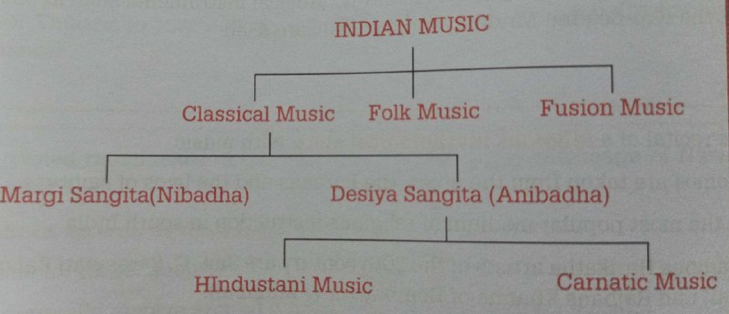
Music
A Fusion genre of music is the combination of two or more genres of music. Sitar maestro Pandit Ravi Shankar was the first person to popularize Indian music at the world level.

Slide 84
Theatre (CO4 & CO5)
It has been postulated that the excavated ruins at Sitabena and Jogimara caves represent the world’s oldest amphitheatres.
Theatre in India began as a narrative art form, which encompassed a concoction of music, dance and acting. Recitation, dance and music were integral parts of theatre.
The Sanskrit word ‘nataka’ was derived from the root word ‘nata’ which actually meant a dancer.
Characters in Sanskrit plays were important. They were broadly classified into three kinds which are Nayaka (Hero or the Protagonist), Nayika (Heroine) and the Vidusaka (Clown).

Slide 85
Theatre
India boasts of a rich tradition of folk theatre in various parts of India.
The traditional folk theatre reflects the various aspects of the local lifestyle including social norms, beliefs and customs.
Types of Folk Theatre:
Ritual Theatre: Ankia Naat, Ramlila, Raslila, Bhuta and Ramman.
Theatre of Entertainment: Bhavi, Garoda, Jatra, Maach, Powada.
South Indian Theatre: Burra Katha, Bayalata, Theyyam, Kuruvanji.
Parsi Theatre, Regional theatre of Bengal, Prithvi theatre are modern Indian theatre.
Sangeet Natak Academy : established on 1952 to promoting performing arts including theatre.

Slide 86
Theatre
Oldest Surviving Sanskrit theatre: Of all the ancient Sanskrit theatre forms, only Koodiyattam from Kerala has managed to survive. It lived within temple precincts, more specifically in the homes of the Chakyars and Nambiars, the two communities who were its sole practitioners.
It is 70 years since Koodiyattam emerged from temples to occupy the public stage as an entertaining theatre form.
It is officially recognized by UNESCO as a masterpiece of the Oral and Intangible heritage of humanity.
Facing Problem:- The more than 1,000-year-old theatre form has just around 100 practitioners, the lack of patronage, a limited repertoire etc.

Slide 87
Drama (CO4 & CO5)
Drama is a narrative art form combining acting, music, dance etc.
Bharat Muni, the author of Natya Shastra, is often called the father of Indian drama.
Drama is a variant of performing art in which stories are enacted by using dialogue, dance, music and acting.
A number of great drama writers were there in India during the ancient age. Among them Bhasa, Kalidas, Vishakhadatta, Shudraka, Bhairavi and Bhavabhuti were the most prominent ones.
Ashvaghosha was the first playwright in Indian history. The origin of Indian drama took place in the age of Rig Veda.

Slide 88
Drama
The Vijayanagar ruler Krishnadeva Raya wrote a Sanskrit drama called Jambavati Kalyanam.
The Chauhan king Vigraharaja IV composed Harakeli Nataka, a drama , in Sanskrit language.
Bhasa was one of the earliest playwrights in India.
King Harshavardhana wrote a drama named Ratnavali.
Shudraka was the author of Mrichchakatikam.
Vishakhadatta wrote Mudrarakshasa and Devichandraguptam.
Kalidasa wrote Abhijnana Shakuntala, Malavikagninitram and Vikramorvasiyam.

Slide 89
Painting (CO4 & CO5)
The history of painting can be traced through the ancient and medieval period where the books were illustrated with paintings.
The history of paintings can be known from primitive rock paintings of Bhimbetaka, Mirzapur and Panchmarhi.
The work on the walls or a solid structure are referred to as Murals.
These have existed in India since ancient times and can be dated between 10th century BC and 10th century AD.
The history of painting can be traced through the ancient and medieval period where the books were illustrated with paintings. Then came the miniature style that dominated the Mughal and Rajput courts.

Slide 90
Painting
CLASSIFICATION OF INDIAN PAINTINGS:
Mural Paintings in India:- The work on the walls or a solid structure are referred to as Murals. These have existed in India since ancient times and can be dated between 10th century BC and 10th century AD.
The beauty and the exquisiteness of mural paintings can be seen in places like Ajanta, Armamalai Cave, Ravan Chhaya Rock Shelter, Bagh Caves, Sittanavasal Caves and Kailasha Temple in Ellora.
Most of the mural paintings are either in natural caves or in rock cut chambers.

Slide 91
Painting
Miniature Paintings in India:- The word ‘miniature’ is derived from the Latin word ‘minium’, which means red lead paint. This paint was often used in the illuminated manuscripts during the Renaissance period.
The painting should not be larger than 25 square inch. The subject of the painting would be painted in not more than one-sixth of the actual size.
In these painting, very fine details were portrayed by the painter. If a miniature painting is observed under a magnifying glass, more details become visible. Under the patronage of Jahangir, remarkable progress in the field of painting was witnessed. Under Shah Jahan, painting attained technical perfection but they were without real beauty & emotions.

Slide 92
Martial Arts Traditions (CO4 & CO5)
The term ‘martial art’ refers to creativity exhibited by warriors while fighting against their opponents.
These warrior use different gestures, postures and techniques to overcome the challenge of their opponents.
The martial artists need to acquire knowledge of ‘Marma Shastra’. It is the study of vulnerable spots in human body. These vulnerable spots of the opponents are targeted during fights.
Dhanur veda (Upaveda of Rigveda) contains reference of different forms of artistic skills required by archers. Agni Purana explains the art of warfare in 5 detailed parts.

Slide 93
Martial Arts Traditions (CO4 & CO5)
One of the oldest martial arts in India, Kalaripayattu, although practiced in most parts of Southern India, originated in the state of Kerala around 3rd century BC.
This art form includes mock duels (armed and unarmed combat) and physical exercises.
Silambam, a kind of staff fencing, is a modern and scientific martial art of Tamil Nadu.
One of the most ancient martial arts of Manipur, Cheibi Gad-ga involves fighting using a sword and a shield. Gatka is a weapon-based form of martial arts. Musti Yuddha is an unarmed form of martial arts.

Slide 94
Fairs and Festivals (CO4 & CO5)
Festivals and fairs forms an intrinsic part of Indian culture being an outpouring medium of our beliefs and emotions.
Diwali or Deepawali:- It is the festival of lights celebrated on the on New moon (Amavasya) day in the month of Kartik.
Holi It is the festival of Colours and is celebrated by people across the religion.
Eid-ul-Fitr :- The festival falls after the last day of the holy month of Ramadan (Ramzan), which is the ninth month of the Islamic calendar.
Christmas :- This day is celebrated all across the world as the birth anniversary of Jesus Christ.

Slide 95
Festivals
Bihu :- State festival of Assam. Bohag Bihu is celebrated to symbolize the beginning of Assamese new year around 13-14 April. Associated with farming.
Pongal:- Pongal is four day harvest festival celebrated by Tamils around the world. It is celebrated in January and marks the beginning of Uttarayan, i.e. six month northward journey of the Sun.
Onam:- Onam, the State festival of Kerala falls in the beginning of the month of Chigam, the first month of the Malayalam calendar. It is mainly a harvest festival but it also celebrates the homecoming of mighty asura King Mahabali from Patala (the underground).

Slide 96
Festivals
Hornbill Festival :- It is one of the major festival celebrated in Nagaland. It is a 10 day festival that begins on 1st December every year. All the tribes showcase their talent and cultural vividness through costumes, weapons, bows and arrows and headgears of the clans.
Cheiraoba Festival:- This festival is celebrated all across the State of Manipur, as it is the New Year according to the Manipuri tribes.
Wangala Festival (The 100 Drums Festival):-The dominant Garo Tribe primarily celebrates it in Meghalaya. The festival indicates the beginning of winter and is celebrated as a nod to the post harvest season.

Slide 97
Fairs
A Fair is a temporary gathering of people for a variety of activities which may be religious, entertainment or commercial.
Kumbh Mela:- The Kumbh Mela is the largest religious gathering in the world. Every day millions of people come to take a dip in the holy river. The mela (gathering) is held on a rotational basis at four auspicious pilgrimage sites- Prayagraj, Haridwar, Nashik and Ujjain.
Sonepur Mela:-It is one of the largest cattle fairs in Asia. The mela is held in Sonepur, Bihar at the confluence of the River Ganga and the Gandak. It usually takes place in November on the Kartik Poornima. It is the only fair where large numbers of elephants are sold.

Slide 98
Fairs
Pushkar Fair:- Pushkar Mela is an annual fair in Pushkar, Rajasthan starting on the day of ‘Kartik Poornima’ and lasts for about a week. It is one of the largest camel and cattle fairs in the world. When the festival actually begins, events like camel races, moustache competitions, turban tying competitions, dancing and camel riding, etc. take centre stage.
Ambubachi Mela:- This is an annual fair held at Kamakhya Temple in Guwahati (Assam). It is organized during the monsoon season. It is also known as the ‘Tantric Fertility Festival or Ameti Festival because it is based on the cult of Tantric Shakti.

Slide 99
Recap
In this topic ,we learned about Music, Theatre, drama &Painting, Martial
Arts Traditions, the Fairs and Festivals

Slide 100
Daily Quiz
The Hornbill festival is celebrated in which state of the following state?
A. Manipur
B. Mizoram
C. Nagaland
D. Meghalaya
The Wangala festival is celebrated in which state of the following ?
A. Manipur
B. Mizoram
C. Nagaland
D. Meghalaya
Pushkar Mela is an annual fair in Pushkar, Rajasthan starting on the day of ‘Kartik Poornima’ and lasts for about a week.
A. True
B. False

Slide 101
Daily Quiz
______is often called the father of Indian drama.
A. Kalidasa
B. Bhasa
C. Bharat Muni
D. Shudraka
Which of the following martial art is the oldest martial arts in India?
A. Silambam
B. Gatka
C. Kalaripayattu
D. Inbuan
Mural Paintings was often used in the illuminated manuscripts during the Renaissance period.
A. True
B. False

Slide 102
Daily Quiz
______was the first person to popularize Indian music at the world level.
A. Gopal Mishra
B. Pandit Ravi Shankar
C. Ustad Alladiya Khan
D. Pandit Omkarnath Thakur
Which of the following is the Oldest Surviving Sanskrit theatre in India?
A. Bayalata,
B. Theyyam,
C. Koodiyattam
D. Kuruvanji
Which of the following is ritual theatre in India
A. Ankia Naat
B. Garoda
C. Jatra
D. Maach

Slide 103
Weekly Assignment
Explain the Drama and write the different theatre in India.
Explain Martial arts.
Write down the difference between Carnatic music and Hindustani music.

Slide 104
Prerequisite
Basic knowledge of Indian Art.

Slide 105
Topic Objective
Topic No. | Topic Objective
1 | To study the Current developments in Arts and Cultural and the Indian’s Cultural Contribution to the World
2 | To study the Indian Cinema

Slide 106
Topic Mapping
S.No. | Topic | Course Outcome
1 | Current developments in Arts and Cultural | CO4 & CO5
2 | Indian’s Cultural Contribution to the World & Indian Cinema | CO4 & CO5

Slide 107
Current developments in Arts and Cultural (CO5)
Statue of Unity:- It is the statue of Sardar Vallabhbhai Patel. It is located on the banks of river Narmada at Kevadia in Gujarat. It is the world’s tallest statue. Its height is 182 metres. It was designed by Ram V. Sutar. He is a famous Indian Sculptor. Crossed 50 lakhs visitors since its inauguration in 2018.
The geometrically designed base is situated on its own riverine island and is linked to the main land mass by a bridge for vehicles and pedestrians.
The Statue of Unity (SoU) will be the highest statue in the world at 182 metres from the road entry and 208.5 metres from the river entry,

Slide 108
Current developments in Arts and Cultural (CO5)
surpassing China's 153-metre-tall Spring Temple Buddha and standing nearly twice as tall as the Statue of Liberty in New York.
It is capable of enduring wind gusts of over 220 km/h while enduring earthquakes 6.5 on the Richter Scale or greater.
The Statue of Unity is a true feat of engineering. It honours the engineering prowess of India.
The bronze statue of Sardar Vallabhbhai Patel, created by Indian sculptor Ram V. Sutar, stands almost 50 storey tall and rests on a base with three tiers, setting a world record for height.

Slide 109
Current developments in Arts and Cultural (CO5)
Statue of Equality: The Prime Minister, Shri Narendra Modi dedicated to the nation the ‘Statue of Equality’ in Hyderabad on 5th February 2022.
The 216-feet tall Statue of Equality commemorates the 11th century Bhakti Saint Sri Ramanujacharya, who promoted the idea of equality in all aspects of living including faith, caste and creed.
The Statue is made of ‘panchaloha’, a combination of five metals: gold, silver, copper, brass, and zync and is among one of the tallest metallic statues in sitting position, in the world.

Slide 110
Current developments in Arts and Cultural
It is mounted on a 54-ft high base building, named ‘Bhadra Vedi’, has floors devoted for a Vedic digital library and research centre, ancient Indian texts, a theatre, an educational gallery detailing many works of Sri Ramanujacharya.
The statue has been conceptualised by Sri Chinna Jeeyar Swami of Sri Ramanujacharya Ashram.
During the programme, 3D Presentation Mapping on the life journey and teaching of Sri Ramanujacharya was showcased. Prime Minister visited the identical recreations of 108 Divya Desams (ornately carved temples) that surround the Statue of Equality.
Sri Ramanujacharya worked tirelessly for the upliftment of people with the spirit of every human being equal regardless of nationality, gender, race, caste or creed. The inauguration of the Statue of Equality is a part of the 12-day Sri Ramanuja Sahasrabdi Samaroham, the ongoing 1000th birth anniversary celebrations of Sri Ramanujacharya.

Slide 111
Current developments in Arts and Cultural (CO5)
Kartarpur Corridor:- It is a visa-free cross-border corridor that connects Gurudwara Darbar Sahib located in Pakistan and the Indian border. The length of this corridor is 4.7 km. It connects Dera Baba Nanak town(Gurdaspur district of Indian Punjab) with Kartarpur (Narowal district, Pakistan Punjab).Guru Nanak died here in 1539.
Bharati Script:- It has been developed by a team led by Srinivasa Chakravarthy. It is unified script combining 9 Indian languages, which are Devanagari, Gurumukhi, Bengali, Gujarati, Oriya, Malayalam, Telugu, Kannada and Tamil.

Slide 112
Current developments in Arts and Cultural
Azadi Ka Amrut Mahotsav:- Azadi Ka Amrut Mahotsav is a series of events to be organised by the Government of India to commemorate the 75th Anniversary of India’s Independence. The Mahotsav will be celebrated as a Jan-Utsav in the spirit of Jan-Bhagidari. Amrit Mahotsav programme began with Dandi March from Sabarmati Ashram. The March had a key role in furthering a spirit of pride and Aatmanirbharta among India’s people. It is a 75 week festival.
Azadi Ka Amrut Mahotsav has five pillars namely:
Freedom Struggle,
Ideas at 75,
Achievements at 75,
Actions at 75 and
Resolves at 75.

Slide 113
Current developments in Arts and Cultural
This Mahotsav is dedicated to the people of India who have not only been instrumental in bringing India thus far in its evolutionary journey but also hold within them the power and potential to enable Prime Minister Narendra Modi's vision of activating India 2.0, fuelled by the spirit of Aatmanirbhar Bharat.
Azadi ka Amrit Mahotsav being celebrated in the spirit of Jan Bhagidari, seeks to showcase country’s achievements of these 75 years to the world and also give a framework for resolves for the next 25 years.A large number of initiatives both within and outside the country have been taken up under this campaign.

Slide 114
Current developments in Arts and Cultural
Dandi March to mark 75 Years of Independence :- Prime Minister Narendra Modi on 12th march flagged off the foot march to re-enact the historic Mahatma Gandhi-led Salt March, while launching the ‘Azadi Ka Amrut Mahotsav’, the government’s initiative to mark 75 years of India’s Independence.
The padayatra is being undertaken by 81 persons on April 5. The march from Sabarmati Ashram in Ahmedabad to Dandi in Navsari district, a distance of 386 km, will take them 25 days. For Indians, salt represented honesty, trust, loyalty, labour, equality and self reliance. At that time, salt was a symbol of India’s self-reliance. Along with the values of India, the British had also hurt this self-reliance.

Slide 115
Current developments in Arts and Cultural
Sangeet Sandhya programme:- Sangeet Sandhya programme started as part of the 550th Birth Anniversary celebrations of Sri Guru Nanak Dev Ji.
Chauri Chaura Centenary Celebrations :- This year marks 100 years of the ‘Chauri Chaura’ incident, a landmark event in the country’s fight for independence.
Ek Bharat Shreshtha Bharat:- It is an initiative of Government of India to foster national integration by a coordinated mutual engagement process between States, UT, Central Ministries, Educational Institutions and general public through linguistic, literary, cultural, sports, tourism and other forms of people-to-people exchanges.

Slide 116
Current developments in Arts and Cultural
National War Memorial:- The National War Memorial, near India Gate in New Delhi, is a fitting tribute to our soldiers who laid down their lives defending the nation, post-independence.
The National War Memorial also commemorates the soldiers who participated and made the supreme sacrifice in Peace Keeping Missions, and Counter Insurgency Operations.
The layout of the National War Memorial comprises four concentric circles, namely, the ‘Amar Chakra’ or Circle of Immortality, the ‘Veerta Chakra’ or Circle of Bravery, the ‘Tyag Chakra’ or Circle of Sacrifice, and the ‘Rakshak Chakra’ or Circle of Protection.

Slide 117
Current developments in Arts and Cultural
National War Memorial represents the culmination of the collective aspiration of a grateful nation to pay a fitting tribute to the martyrs.
Gandhi Circuit, Bihar :- The Government has announced development of Gandhi Circuit in Bihar to celebrate the centenary of the Champaran Satyagraha organized in 1917.The project has been named as the “Development of Gandhi Circuit: Bhitiharwa- Chandrahia-Turkaulia under Rural Circuit theme of Swadesh Darshan Scheme”.
Pilgrimage Rejuvenation and Spiritual Augmentation Drive (PRASAD):- To identify & develop pilgrim sites in India to improve religious tourism experience.

Slide 118
Current developments in Arts and Cultural
Sanskriti Kumbh, a 29 days Cultural extravaganza organised at Kumbh Mela Area, Prayagraj from 10th January, 2019.
New campus of National Museum Institute inaugurated at Noida on 30th January, 2019.
The 20th edition of Bharat Rang Mahotsav (BRM), the international theatre festival of India, is organized by National School of Drama.
Foundation Stone of Taj View Garden on the Taj Corridor Area between the Agra Fort and TajMahal in Agra was laid on 14thFeburary, 2019.
The ‘Azaadi ke Diwane’ museum was inaugurated at Red Fort, Delhi on 4th March, 2019.

Slide 119
Indian’s Cultural Contribution to the World (CO4 & CO5)
Spread of Indian religion and philosophy.
Spread of Mathematics, Astronomy and Medical science.
Spread of Indian art and architecture.
Spread of Indian languages.
Spread of Indian games and leisure activities.
1. Chess & martial arts
2. Ludo:- known as Pachisi in ancient times
3. Krida-Patram:- Modern play cards
4. Kho-Kho:- originated in the state of Maharashtra.

Slide 120
Indian Cinema (CO4 & CO5)
The Lumiere Brothers who are famous as the inventors of Cinematograph brought the concept of motion pictures to India. They exhibited six-soundless short films in Bombay in 1896, which managed to engross the audience.
Shot by an unknown photographer in 1897, the first film was titled Coconut Fair and Our Indian Empire.
The first motion venture by an Indian was by Harishchandra Bhatavdekar, who was popularly known as Save Dada.
Dadasaheb Phalke who produced the film titled Raja Harishchandra in 1913 made the first indigenous Indian silent film.

Slide 121
Indian Cinema
The Era of Silent Films:- The decade of 1910 to 1920 was dominated by silent films. The first Indo-British Collaboration for making a silent movie was in 1912 by N.G. Chitre and R.G. Torney. Their film was titled Pundalik. Dadasaheb Phalke who produced the film titled Raja Harishchandra in 1913 made the first indigenous Indian silent film.
Age of Talking films or Talkies :- The first talking film was Alam Ara, which was directed by Ardeshir Irani in 1931. This film had a few memorable songs by W.M. Khan, who was India’s first singer and his song ‘De de khuda ke naam par’ was the first recorded song in Indian cinematic history.

Slide 122
Indian Cinema
The Golden era of Indian Cinema(1940-1960):- Towards the late 1940s,Indian cinema picked up the new ‘masala’ themed films depicting music, dance and romance. Establishment of RK Studios gave boost to this new trend. This gave birth to a new phase of Indian films referred as ‘ The Golden Era of Indian cinema’.
The music industry became an integral part of the film fraternity in the 1960s. Several movies started using music as their unique selling point (USP). Some of the notable ones were Jis Desh mein Ganga Behti hai, starring Raj Kapoor, Dev Anand’s Guide, Yash Chopra’s Waqt, etc. This period also witnessed two wars of 1962 and 1965, which became the subject of several nationalistic films(Haqeeqat, Aradhana, Sangam etc.)

Slide 123
Indian Cinema
Classic Decades of Indian Cinema(1970-1980):- The films of this phase were characterized by a mixture of genre of romance and action. The term ‘Bollywood’ was coined during the 1970s with the establishment of ‘Conventions of commercial Bollywood Films (CCBF)’.
Phase of Romantic cinema1980-2000 :- Romantic movies and family dramas were also getting a huge audience. Three major actors of this period were Anil Kapoor, Jackie Shroff and Govinda. LPG in 1990s allowed for advanced technology to come to India. My Dear Kuttichatan was India’s first 3D movie that was made in Malayalam. The Dolby Sound System also introduced this time.

Slide 124
Indian Cinema
New Bollywood phase of Indian Cinema(1990-present):- Indian cinema with its growing popularity has become an inseparable part of the lives of people.
SOUTH INDIAN CINEMA :-The cinema of South India can be used to refer collectively to the five film industries of South India—the Tamil, the Telugu, the Kannada, the Malayalam, and the Tulu (Coastal Karnataka) film industries as a single entity. Films based on socio-economic issues form a major component of South Indian cinema.
World’s largest movie poster ever: Karan Johar and SS Rajamouli’s magnum opus, Bahubali, has entered the Guinness Book of World Records.

Slide 125
Academy award 2023
Documentary Film maker, Kartiki Gonsalves, and producer, Guneet Monga, won the Oscar for their short film ‘The Elephant Whisperers’. The film was applauded in the ‘Best Documentary Short Film’ category. The film is based on the lives of Bomman and Billie, a couple from the Kattunayakan tribe who devote their lives to the care of an orphaned baby elephant.
The second Oscar was awarded to the Indian musical composer, M.M Keeravani, and Lyricist, Chandrabose for their song ‘Naatu Naatu’ from the movie RRR. The song won the honour in the ‘Best Original Song category'. The feature film is based on the life of a fearless revolutionary.

Slide 126
Recap
In this topic ,we learned about Music, Theatre, drama &Painting, Martial
Arts Traditions, the Fairs and Festivals
We have also learned the Current developments in Arts and Cultural,the Indian’s Cultural Contribution to the World & the Indian Cinema.

Slide 127
Daily Quiz
Who has developed Bharti Script?
A. Yogesh Chandrahasan
B. Shashi Prabhu
C. Ram V. Sutar
D. Srinivasa Chakravarthy
Consider the following statements about ‘Kartarpur Corridor’:
Statement I: It is a visa-free cross-border corridor.
Statement II: It connects Amritsar with Kartarpur (Pakistan).
Statement III: Kartarpur was the birth place of Guru Nanak.
Which of the statements given above is/are correct?
A. Only I
B. Only I and II
C. Only II and III
D. All of the above

Slide 128
Daily Quiz
Kho-Kho originated in the state of _____?
A. MP
B. UP
C. Maharashtra
D. Rajasthan
What is Bharat Rang Mahotsav?
(a) International Film festival of India
(b) National film festival of India
(c) International theatre festival of India
(d) National theatre festival of India
The Lumiere Brothers brought the concept of motion pictures to India.
A. True
B. False

Slide 129
Daily Quiz
Indian Film industries is known as____?
A. Kollywood
B. Hollywood
C. Bollywood
D. Tollywood
________is India’s first 3D movie.
A. Bahubali
B. Thailayva
C. My Dear Kuttichatan
D. Raaz 3D
De de khuda ke naam par’ was the first recorded song in Indian cinematic history.
A. True
B. False

Slide 130
Weekly Assignment
Explain the development of Indian film industries.
Explain India’s culture contribution to the world.

Slide 131
Faculty Video Links, YouTube & NPTEL Video Links and Online Courses Details
YouTube/other Video Links
https://www.youtube.com/watch?v=wjepzXnEqYo
https://www.youtube.com/watch?v=AnGJ7zwyCAk
https://www.youtube.com/watch?v=5xpJeO_syN4&t=832s
https://www.youtube.com/watch?v=IGOJMQC7Jy4

Slide 132
MCQs
‘Odishi’ is the classical dance belonging to the state of ______.
A. Tamilnadu
B. Andhra Pradesh
C. Odisha
D. Assam
What does stupa signify?
A. Death
B. Knowledge
C. Birth
D. Parinirvana
The Nagara style of architecture developed and flourished mainly in north India.
A. True
B. False

Slide 133
MCQs
The arrival of Babur into India led to the
(i) introduction of gunpowder in the subcontinent
(ii) introduction of the arch and dome in the region’s architecture
(iii) establishment of Timurid dynasty in the region
Select the correct answer using the code given below.
(a) (i) and (ii) Only
(b) (iii) Only
(c) (i) and (iii) Only
(d) (i), (ii) and (iii)
With reference to the cultural history of India, the term Panchayatan refers to?
(a) An assembly of village elders (b) A religious sect
(c) A style of temple construction (d) An administrative functionary

Slide 134
MCQs
To which school of painting Bani-Thani was related?
A. Bundi School
B. Kishangarh school
C. Chawand School
D. Jaipur School
Puppetry is divided into ___categories.
(a) 4
(b) 5
(c) 3
(d) 2
The Lumiere Brothers brought the concept of motion pictures to India.
A. True
B. False

Slide 135
Old Question Papers
This is new subject so no old question paper is available.

Slide 136
Expected Questions for University Exam
To what extent has the urban planning and culture of the Indus Valley Civilisation provided inputs to the present day urbanisation?
Why is Laurie Baker called “The Conscience Keeper of Indian Architecture”?
What are the difference between Architecture & Sculpture ?
Write about the chief features of the town planning in Indus Valley Civilisation?
Architecture, with the arrival of Mughals, saw a pragmatic shift both in style as well as theme. Critically examine.

Slide 137
Summary
In this unit, we learned about Indian Architect, Engineering and Architecture in Ancient India
We also studied, Sculptures, Seals, coins, Pottery, Puppetry, Dance, Music, Theatre, drama, Painting, Martial Arts Traditions.
In this unit, Fairs and Festivals, Current developments in Arts and Cultural
We also studied, Indian’s Cultural Contribution to the World and Indian Cinema

Slide 138
References
V. Sivaramakrishna (Ed.), Cultural Heritage of India-Course Material, Bharatiya Vidya Bhavan, Mumbai, 5th Edition, 2014
S. Baliyan, Indian Art and Culture, Oxford University Press, India
Romila Thapar, Readings In Early Indian History Oxford University Press , India
P R Sharma ( English translation), Shodashang Hridayam
Basham, A.L., The Wonder that was India (34th impression), New Delhi, Rupa & company
Sharma, R.S., Aspects of Political Ideas and Institutions in Ancient India(fourth edition), Delhi, Motilal Banarsidass
Thank You

